Slide 1
Software Development in the Next Decade: Beyond the Dichotomy of Open-Source and Corporate Worlds
Jinglei Ren and Hezheng Yin
Persper Foundation
Microsoft Research
UC Berkeley
(Advised by Armando Fox from UC Berkeley)

Slide 2
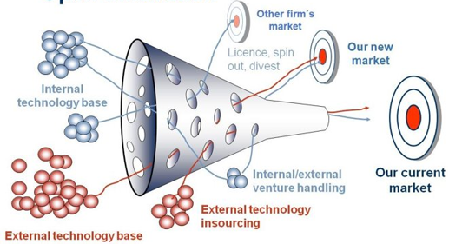
Classic Open Innovation

Slide 3
Why do we need a firm for software development?

Slide 4
Corporate World vs. Open-Source World

Slide 5
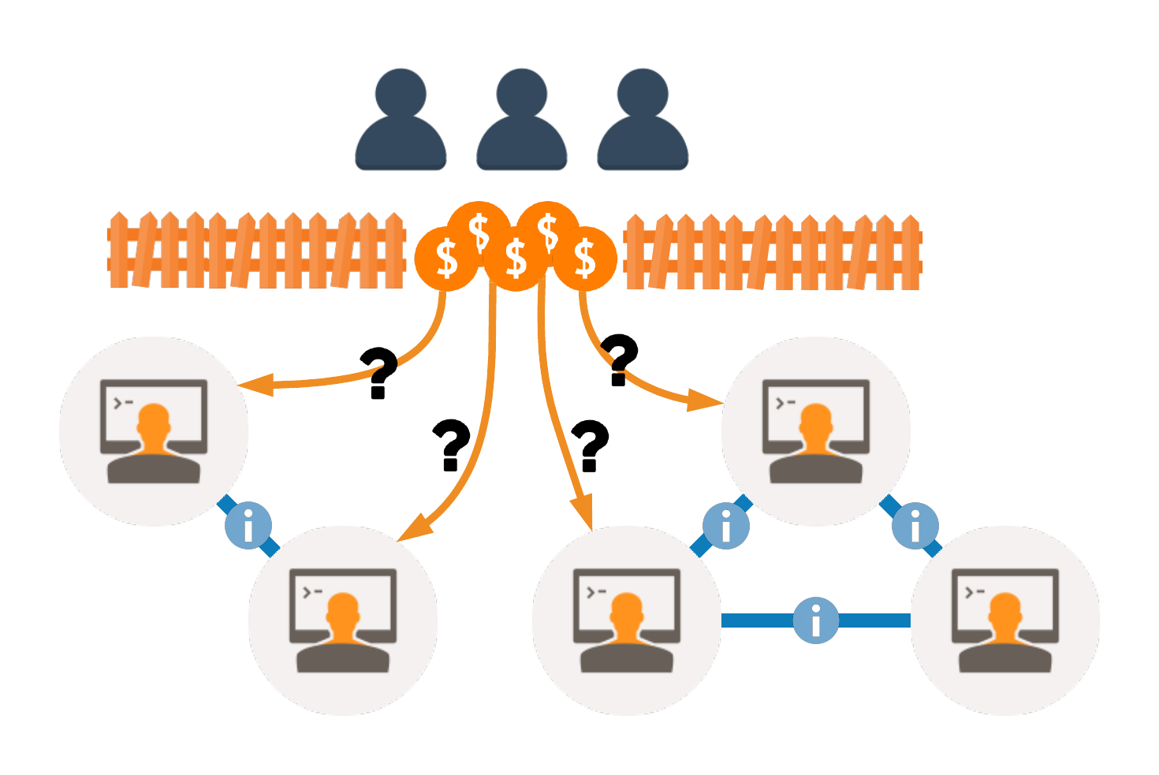
Information Asymmetry
How to allocate value?
Users don't understand developers' work.
Developers don't understand all others' work.
Solution I: Corporate structures
Solution II: Relinquish the value

Slide 6
Transaction Cost
Suppose n developers and m users
# of contracts = O(n + nm)
Dynamics of the network
Turnover of developers
Churn of users
Solution I: Legal person
Solution II: Open source license
Under Shutterstock Standard License

Slide 7
Overview
Open-source issues
Corporate issues
Technologies with potentials
Persper: Assessing code contributions ➟ Information asymmetry
Drepo: Decentralized value sharing ➟ Transaction cost
Virtual shareholding: Beyond the dichotomy
Value-shared open source
Virtual closed corporation
Virtual open corporation

Slide 8
Open-Source Issues
No general method for value allocation
All or some have to relinquish the value they create
Financial crisis or limit
Business models and their limitations

Slide 9
Corporate Issues
Unfair value allocation
Unnecessary operating overhead

Slide 10
Persper: Assessing Code Contributions
Classic economics: value in use
Modern economics: demand and supply
Program analysis and natural language processing

Slide 11
Persper: Assessing Code Contributions

Slide 12
Drepo: Decentralized Value Sharing
Smart contracts reduce the cost of trusting, contracting and enforcing.
The legal framework: IP pooling

Slide 13
Drepo: Decentralized Value Sharing

Slide 14
Virtual Shareholding: Beyond the Dichotomy
Value-shared open source
Virtual open corporation
Virtual closed corporation

